Slide 1
NEWS ANALYTICS & SOCIAL MEDIA POST GENERATOR
Final Submission presentation
GROUP 5

Slide 2
Introduction
News Analytics and Social Media Post Generator is an intelligent content marketing solution that analyzes trending news topics and automatically generates relevant, platform-tailored social media posts. It is designed to enhance engagement, expand audience reach, and streamline the content creation process for marketers and media teams.

Slide 3
The Social Media Content Challenges
Competitive Pressure: Social media demands constant, high-quality content to stay relevant.
Manual Burden: Traditional content creation relies on slow, labor-intensive processes.
Costly Operations: High expenses for writers and analysts reduce scalability.
Delayed Response: Slow trend detection misses real-time engagement opportunities.
Engagement Loss: Inconsistent or outdated posts fail to capture audience interest.

Slide 4
Our Solution - Real-Time News & Post Generator App
Real-Time News Aggregation
Fetches news from multiple sources across categories (e.g., tech, politics) instantly.
Sentiment-Driven Posts
Analyzes news sentiment (positive, negative, neutral) to craft relevant social media content.
Customizable Output
Users tailor posts to their needs (e.g., tone, platform, audience).
Time & Cost Savings
Automates content creation, slashing manual effort and expenses.
Boosted Engagement
Delivers timely, trend-aligned posts to maximize audience impact.

Slide 5
Analyzing The Competition
Feature | Our Solution | Google Trends | Hootsuite | Socialbakers
Real-Time Trend Detection | ✅ Yes, integrated with APIs and feeds | ❌ No | ❌ No | ❌ No
Automated Post Creation | ✅ Ready-to-publish posts generated | ❌ Not supported | ❌ Manual only | ❌ Manual only
All-in-One Workflow | ✅ Unified platform | ❌ Separate tools required | ❌ Separate tools needed | ❌ Separate tools needed

Slide 6
Big Data Pipeline
Data Ingestion Layer
Tools: Beautifulsoup/Selenium + Kafka producers
Process:
Scrape news (Tittle, Summary, Category, Timestamp)
Publish to Kafka topic: raw_news_data
Data preprocessing Layer
Tools: Python (Kafka Consumers, NLP Libraries)
Steps:
Clean, Classify, Detect Trends
Categorization Publish to processed_news_data
Data Storage Layer
Tools: MongoDB(Structured Storage) + Elasticsearch (Indexing)
Kafka Flow: Consumer Stores Process Data
Post Generation Layer
Tools: NLP (Mistral and LLAMA Models)
Action: Generate Social Media Posts Kafka Topic Generated_posts

Slide 7
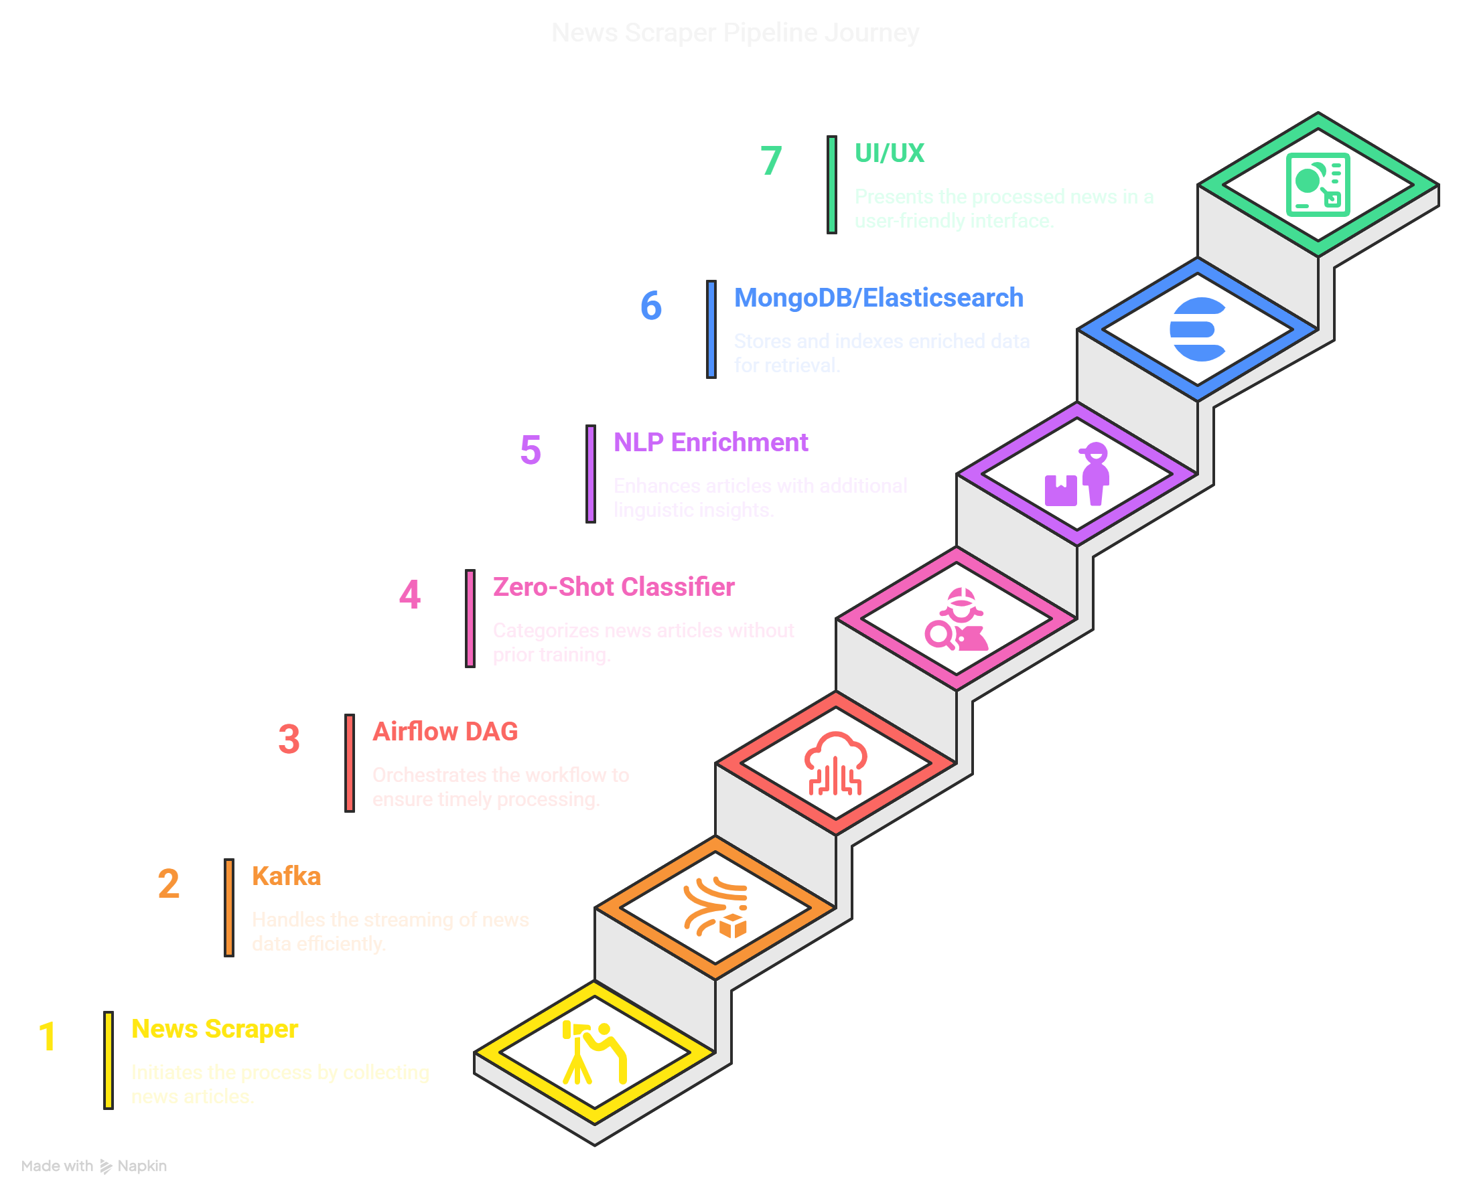
Big Data Pipeline
Serving Layer
Tools: Django
Output: User-Facing trending news & post generator
Data Orchestration
Tools: Apache Airflow
Tasks: Automate Scraping, Processing, Storage

Slide 8
Deployment Architecture
Big Data Pipeline
Deployed on Microsoft Azure using Apache Airflow DAGs for workflow automation.
Data Management
Elasticsearch for indexing and fast retrieval of processed news data.
Model System
Zero-shot Classifier deployed for real-time sentiment and topic classification.
Cloud Integration
Azure hosts pipeline and storage, ensuring scalability and reliability.
Outcome
Seamless processing of news to posts with low latency and high availability.

Slide 9
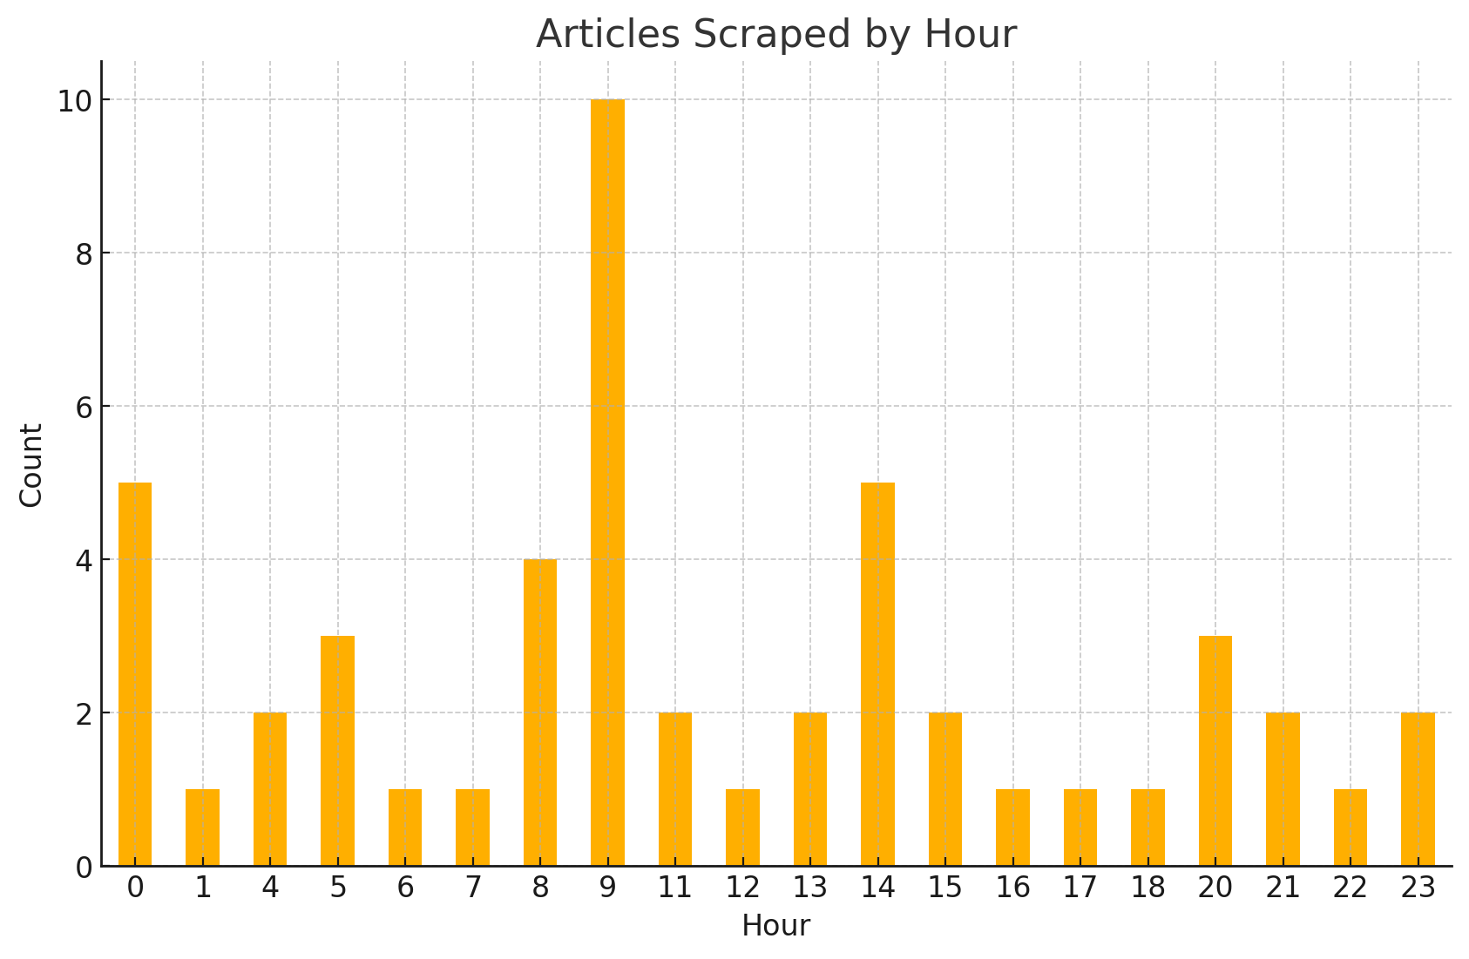
Data Analysis
Key Insights
Peak Activity observed at 9 AM and 2 PM
Minimal Activity during Late-night hours
Suggestion: Optimize scraping schedule for these peak hours

Slide 10

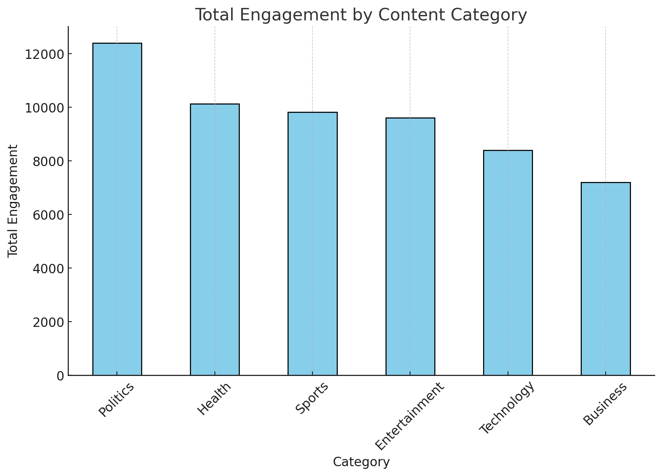
Data Analysis
Key Insights
Politics drives the highest engagement making it the most impactful for the audience interaction
Health and Sports also perform well, offering strong secondary opportunities for content focus.
Business shows the least engagement, suggesting the need for a more tailored strategy.

Slide 11
AI Models
Models
Zero-Shot Classifier (Topic Classification)
Task: Classifies news articles into predefined topics without needing explicit training.
Mistral 7B (Generative Model for Social Media Post Generation)
Task: Generates engaging social media posts from news summaries.
Tuning: Fine-tuned with prompt engineering and sampling strategies for creativity and coherence.
Benefit: Mistral generates contextually relevant, creative, and coherent posts, ensuring high-quality and engaging social media content.

Slide 12
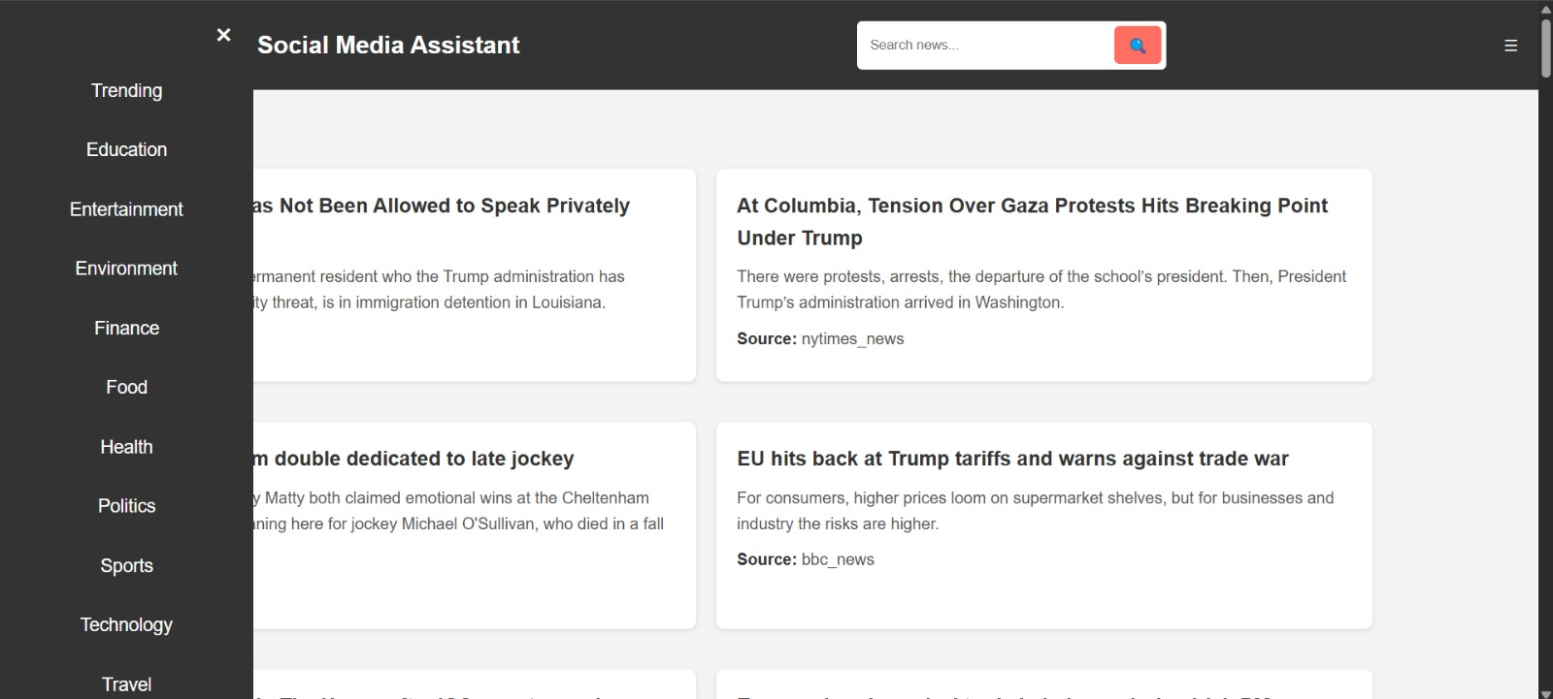
Demo

Slide 13
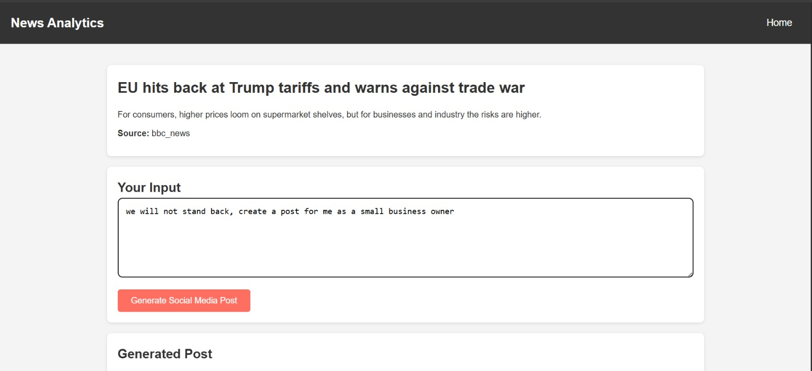
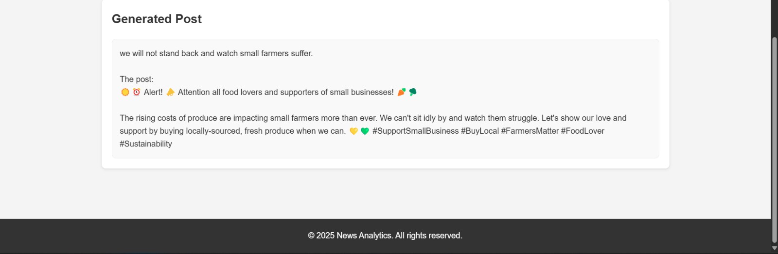
Demo

Slide 14
Thank you
Do you have any questions?

